Slide 1
Choosing the number of clusters
Thang Nguyen

Slide 2
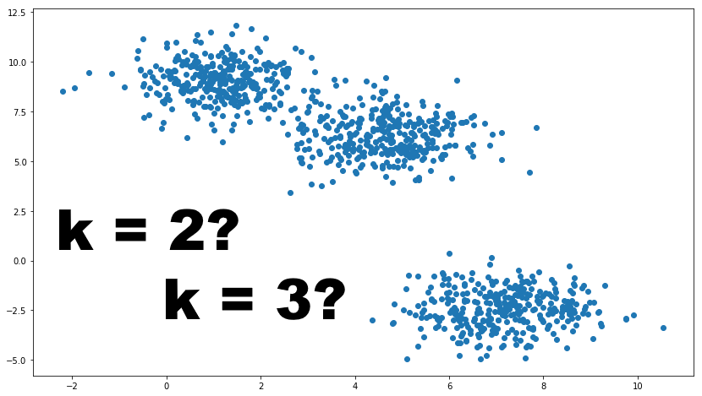
Choosing the value of K

Slide 3
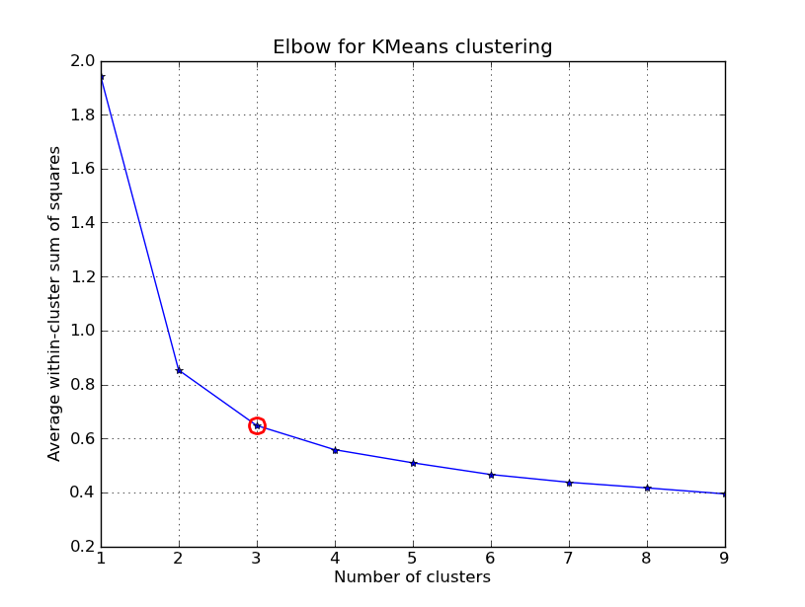
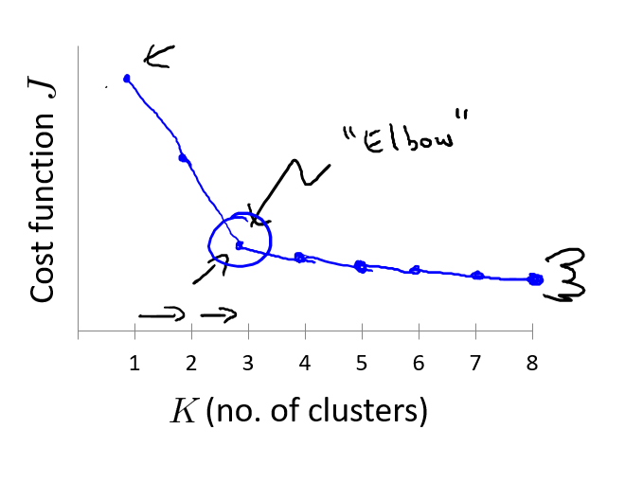
Elbow method

Slide 4
Choosing the value of K
Sometimes, you’re running K-means to get clusters to use for some later/downstream purpose. Evaluate K-means based on a metric for how well it performs for that later purpose.
E.g.
T-shirt sizing
T-shirt sizing
Weight
Weight
Height
Height

